Slide 1
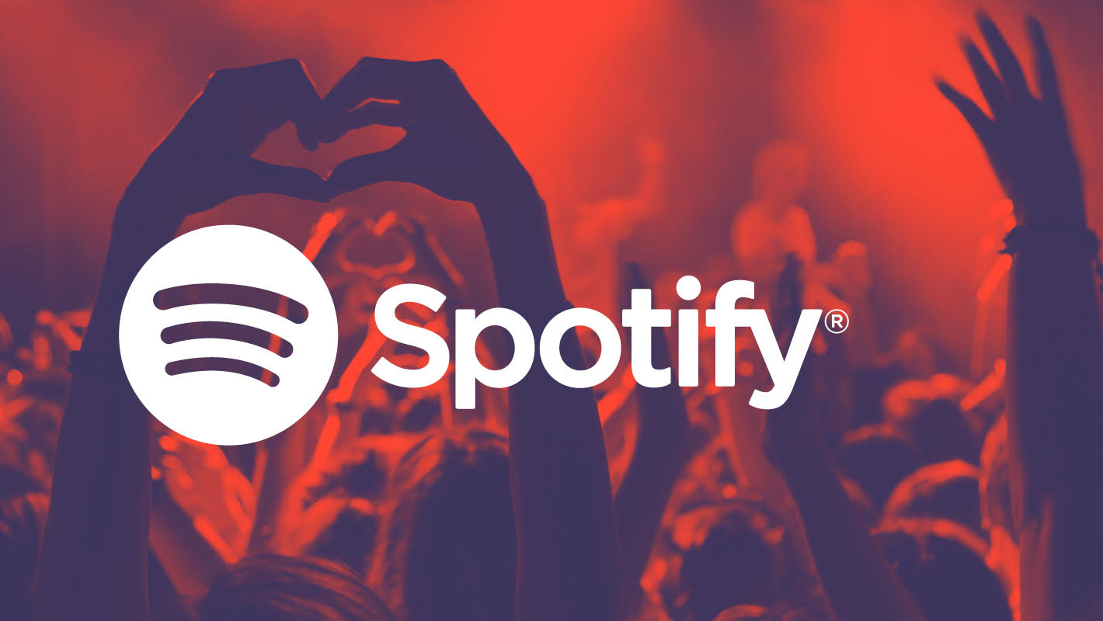

Detailed Slides

Slide 2

Project Goals & Motivation
Out of all the music applications and companies, we decided to use Spotify because not only did we all use Spotify and were regular subscribers, but we also wanted to focus on one of the most innovative music companies during our time.
Another reason why we decided to focus on Spotify was that Spotify has a large user base, which means the trending songs can accurately reflect the taste of the general public
The goal of this project was to develop a visualization that was not only useful to avid music listeners, but also for producers, music record agencies, and advertisement companies. We also aimed to provide detailed analysis of music by category and overtime to provide valuable insights.

Slide 3
Related Work & Inspiration
There were multiple inspirations that we used but one of the biggest inspirations we got was from a dashboard we found online that was similar to that of what we wanted to create: https://public.tableau.com/app/profile/robert.janezic/viz/ALTNATION/AltNation.
Additionally, we tried various methods and visualizations based on what we saw in class (Professor Bockstedt) and from other students presenting. For example, the thought of inserting a music player in the dashboard was inspired by the dashboard that contained a Google Map. The bump chart and sheet swapping of different music features were inspired by visualizations that we learned in class

Slide 4
Questions
After deciding to do our dashboard related to music, the first question had to be deciding what kind of music platform we wanted to do. In the end we chose Spotify over all other platforms as we believed that Spotify was not only the leading music platform, but its big data gathering technique and the fact that they had a user-friendly API made a big difference.
When first devising what to put on the dashboard, we thought it was important, as we are in a business data analysis program, to identify the business context and target customers of our data. The question of “will this be of value to one of our users (avid music listeners, ad companies and music producers)?” was one of the key questions that we took throughout while developing our dashboard.
We then asked the question “what are the basic information we need to start this project?”. It was easy to identify that we needed information regarding the song, genre, the charts and artists. So we headed over to Spotify to download the necessary basic information to get us started.
The next question that we started off was “How do we analyze music? What features can we look at?” Which led us to explore and find the website “organizeyourmusic.com”.
These features will be the most informative aspect in analyzing music by artist and overtime.
After looking into the different features and started making our dashboard, we realized that just the features was not enough. If we wanted to make our dashboard more informative, user friendly and have pretty aesthetics, we needed to scrape additional information. Thus, we utilized the Spotify API and Genius API to download lyrics and other necessary information, like song links, artist/album covers to utilize.
When we downloaded some lyrics from the Genius API, we wondered whether we could develop a sentiment analysis on the lyrics. Thus, on R, we developed a sentiment analysis natural language processing model in order to detect the key words that could provide us with insight regarding the sentiment of each song.

Slide 5
Final Questions To Answer
Dashboard 1:
Choosing from a specific year (between 2016-2020), what artists had the most songs in the top charts? What were their songs?
Within the same year, what genres were the most popular? What songs are in that genre?
What did the distribution of music features look like in that year? For that artist?
Within the same year, what songs match the music feature values that I put in via the sliders?
What do the recommended songs sound like? Can I get more information on the artist's Spotify profile?
Dashboard 2: More specific analysis
How did music trends evolve over time?
What artists stayed relevant over time? In what years?
How did genres rank over time?
Do sadder or happier songs make the charts?

Slide 6
Data
Spotify: From the official Spotify page, we got basic information such as the song title, genre, music chart rankings and artists. This information was critical as it provided us a starting point that we can use to create a structure to connect additional information on to.
OrganizeYourMusic: After getting the basic data from Spotify, we went on to OrganizeYourMusic, a web page, to gather additional information regarding the songs that we have downloaded; for example, acousticness, danceability, popularity, and so on. These were important as they played a key role in developing our first dashboard.
Spotify/Genius API: From the second source, we went online to Spotify and Genius to apply for an API. Then on Python, we used the package “SpotiPy” to access additional information, such as the pictures that we used for the album cover and artists and the song url links. We followed a similar process for scraping lyrics from Genius to use for sentiment analysis. The photos that we got from Spotify API was used in the first dashboard, and the lyrics were a crucial part of our second dashboard.

Slide 7
Exploratory Data Analysis
To explore the data, we used Tableau to see how many distinct artists there are each year to show us if one artist can have multiple top 100 songs. Based on our analysis, we decided to make a chart indicating the artist ranking based on the number of hit songs in this year.
The next thing we are interested in is the genres of these songs. The Exploratory data analysis shows us the number of distinct genres in each year. In fact, there are a lot of different genres. For example, pop music contains dance-pop, art pop, Canadian pop, and more. Therefore, we use the categories of the Grammy Award to generalize the genres and kept it only to broad genres such as pop, country, rap, etc.
Data Disclosure: we manually assigned general genres to each song based on which genre we believed they fit. Thus, our genre label may not be the same as the general public. For example, looping country & folk songs in the same genre.
We kept the original genres in the first dashboard as the treemap and the general genres in the second dashboard as the bump chart.
We also made some box plots to see if the song features (danceability, valence and so on. ) are dispersed enough. If they are all around a single value, the feature controller would be hard to make. This exploratory data analysis leads us to do the sliders.
We also initially analyzed the change of features of songs, to see if there’s evidence change over time.

Slide 8
Data Preparation Pt. 1
After conducting EDA, we recognized that we had to do some work to prepare the data before diving into the design portion of our project.
Generalized genre
As we mentioned before, we prepared our data by generalizing genres in order to make the presentation of data more succinct and less busy looking (very important for bump chart)
Standardizing music feature values
During EDA, we realized that the values for music features were all on different ranges/scales. This posed a problem for comparability and therefore we chose to standardize all features via a calculated field. An example calculation looks like this for the danceability feature:
([Dnce] -{FIXED : MIN([Dnce])}) / ({FIXED : MAX([Dnce])}-{FIXED : MIN([Dnce])})
Calculate lyrics sentiments
To analyze the sentiments of the songs, we used an NLP package called tidytext and an emotional lexicon "Afinn" to generate the sentiments for each song

Slide 9
Data Preparation Pt. 2
Distance algorithm for ranking
In order to make the recommendation system of our first dashboard to be functional, we had to create an algorithm that will allow Tableau to sort through the given music feature values from the sliders, and the values of each song.
The distance is calculated as below, we calculated the distance between the value of features the user selected and the actual features of the songs.
﻿(ABS([Parameters].[Acous] - [Acous_Adjusted]) +
ABS([Parameters].[Dnce] - [Dnce_Adjusted]) +
ABS([Parameters].[Live] - [Live_Adjusted]) +
ABS([Parameters].[Nrgy] - [Nrgy_Adjusted]) +
ABS([Parameters].[Spch] - [Spch_Adjusted]) +
ABS([Parameters].[Val] - [Val_Adjusted]))
Then we rank the distances, and chose the six songs that are most similar to the values of features that the user selected.

Slide 10
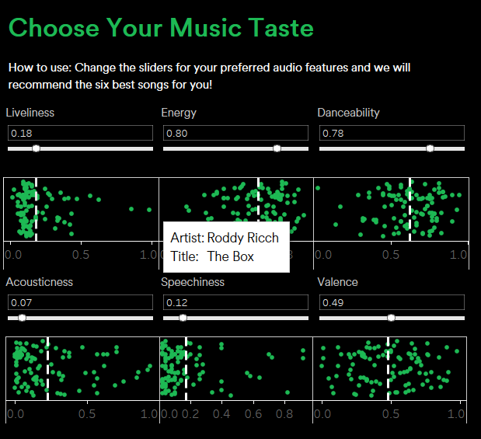
Implementation
Choose your music taste
We used six music features (liveliness, energy, etc.) and made boxplots for each of them, showing the distribution of the features in each year.
We made the dots jittered using RANDOM() to avoid overlapping, got rid of the box and lines, and only kept the average line for simplicity.
Users can hover on the dots to see the song title and artist.
We also put the parameter sliders here for the users to select the specific value for the features and used the distance algorithm to return six songs that are most similar to the features that user selected.
Putting the sliders and boxplots together can help the user to have a look at the distribution when choosing the ”taste”.

Slide 11
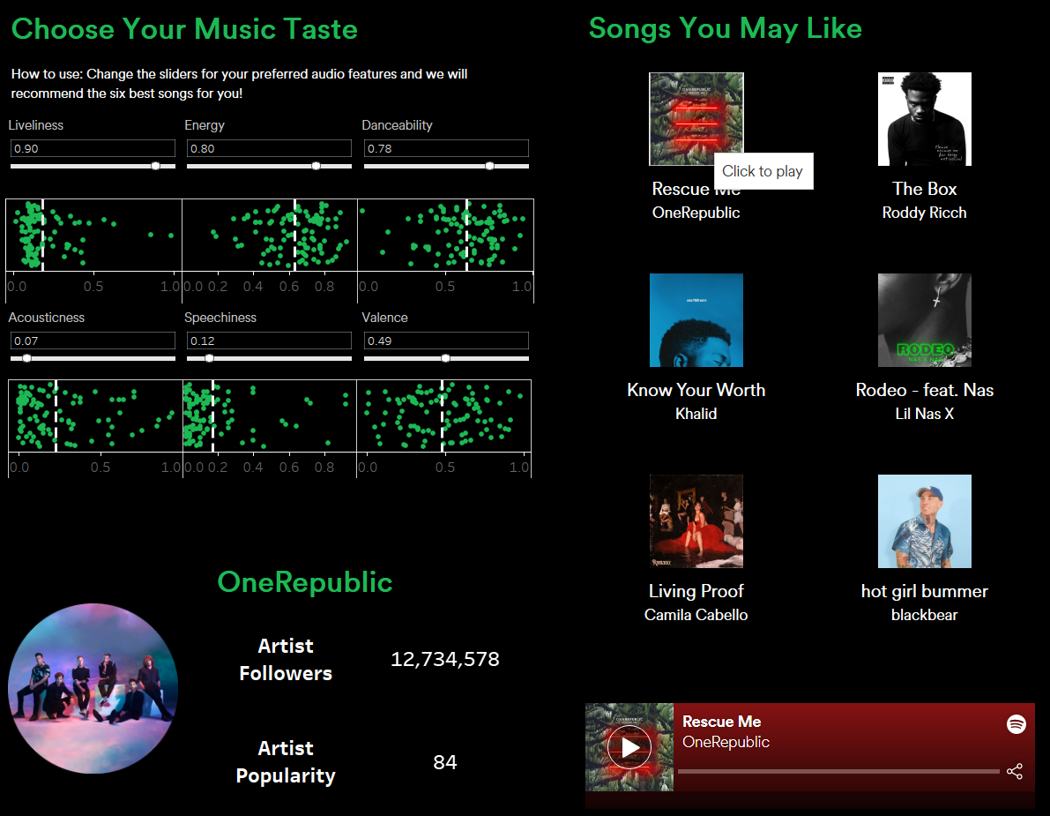
Implementation
Songs you may like
The six songs are ranked by the distance to the values of features the user chose (not popularity). It will automatically change when the user choose the values of features or choose the artist in the artist ranking.
We made a tableau sheet for each song picture and song title. In each of these sheets, we used the ranking (calculated fields) as the filter, and keep the song that is ranked as 1 to 6.
The pictures are interactive using the shapes. We downloaded the album pictures and assigned the pictures to the song titles. The specific url finding and picture downloading process could be found in the Python Script.

Slide 12
Implementation
Artist and Song Player
When a user clicks on the song picture, the artist picture on the middle bottom will change accordingly, and also the number of followers, the number of popularity. The data is acquired using Spotify API. Specific steps are in the python script.
Similarly, when a user clicks on the song picture, the song player will show the song and the user can click on the player to play the music. It is achieved using the embedded Spotify urls to the song, acquired using Spotify API.

Slide 13
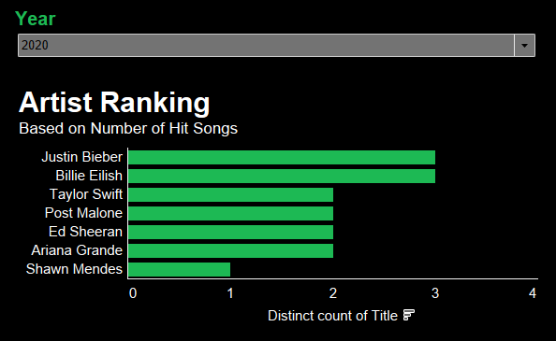
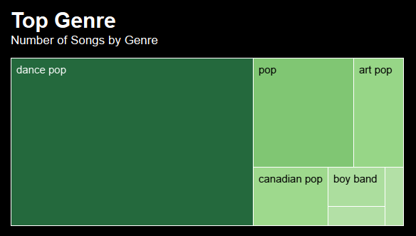
Implementation
Artist ranking:
After selecting a year (or all years), the user can see the artist ranking by the number of hits songs for that time range. For example, here after selecting 2020, we can observe that Justin Bieber and Billie Eilish are the two top artists with the most top 100 hit songs.
It is also a filter - users can select an artist here, and that will filter the entire dashboard to only that artist.
Top Genre:
The top genre is also based on the selected year (and the selected artist, if any). Now because we did not select any artist, we can see the top genres for the year 2020. We chose a treemap because the size of each block can give users a quick intuitive understanding of the presence of each genre. Here we can see that dance-pop is the most trending genre among the 100 top hits in 2020.

Slide 14
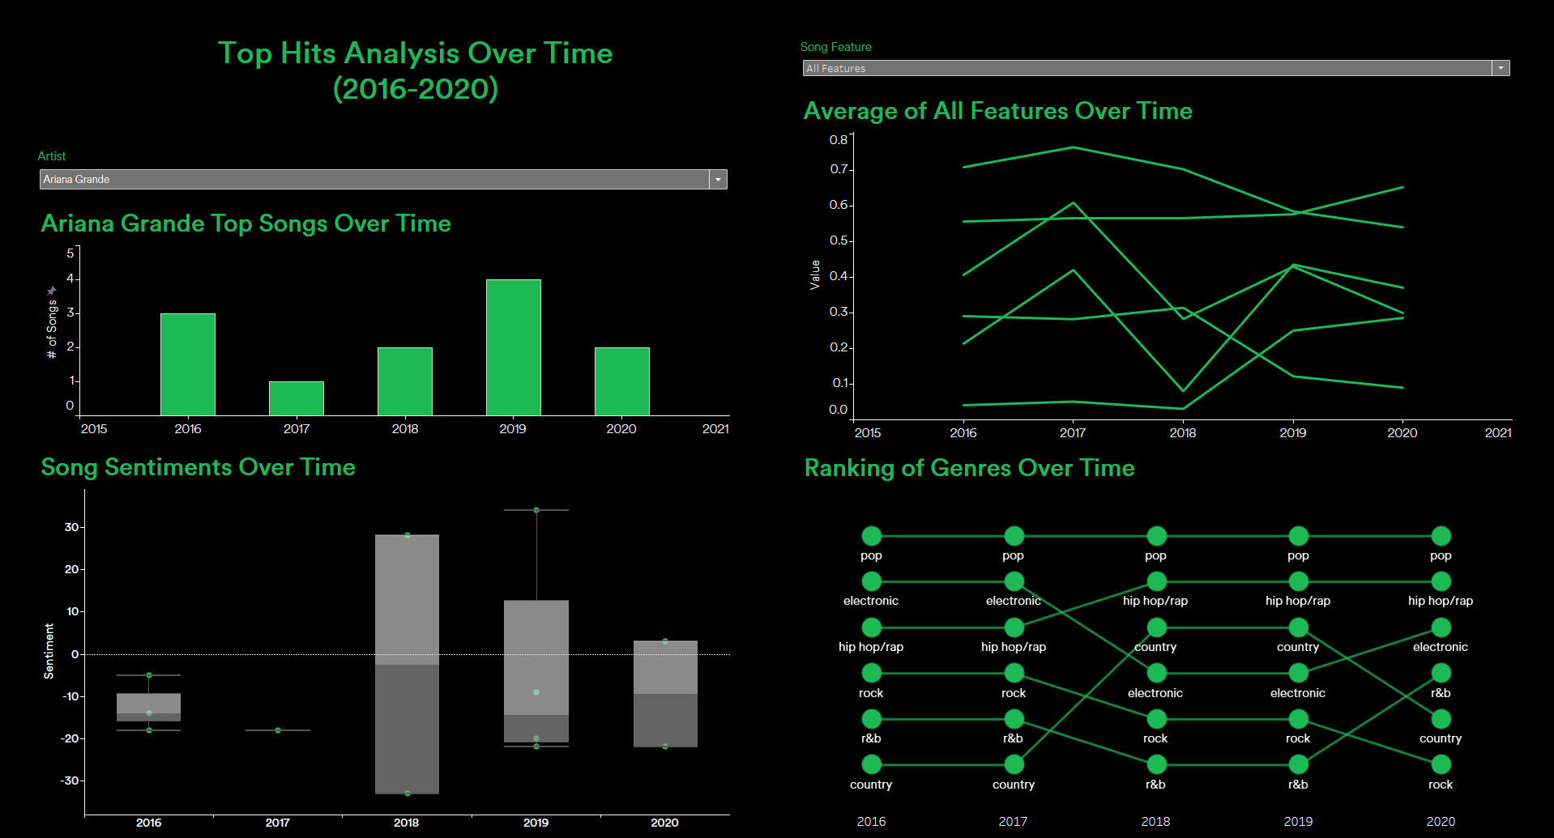
Implementation: Dashboard 2
The purpose of this dashboard is to give a more in depth analysis of top music from 2016-2020. It consists of four visualizations: a bar chart that will populate how many top songs in each year a selected artist has, a line chart that changes/swaps out depending on which music feature the user would like to see the trend of over time, a box plot that shows sentiment analysis of songs over time and a bump chart that shows how the six main genres rank over time.
To use this dashboard, we can start off by picking an artist from the drop down filter. The user is given artists to choose from, or they can simply type in their artist of choice via the search text box filter. This will populate the entire dashboard (with the exception of the bump chart) to filter data only related to Ariana Grande. Here is a screenshot of that dashboard populated to Ariana Grande's music data.

Slide 15
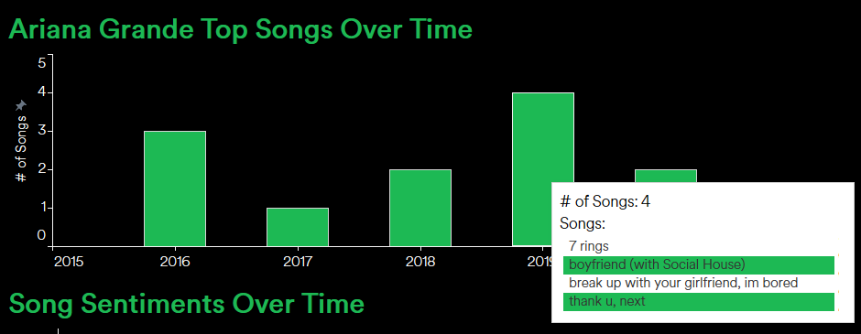
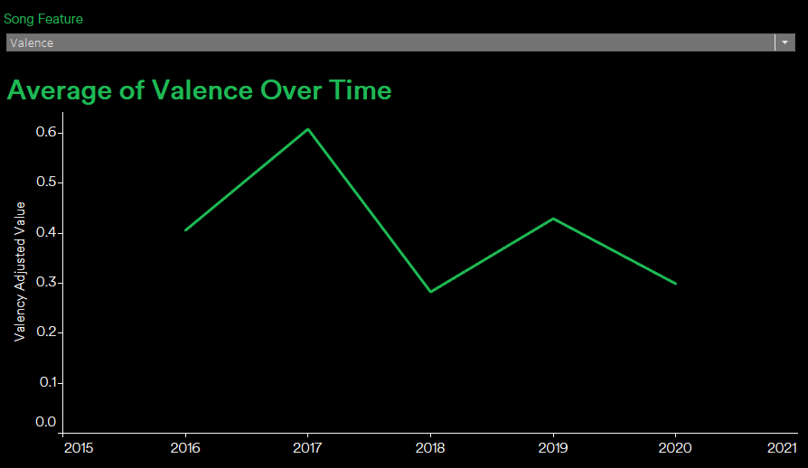
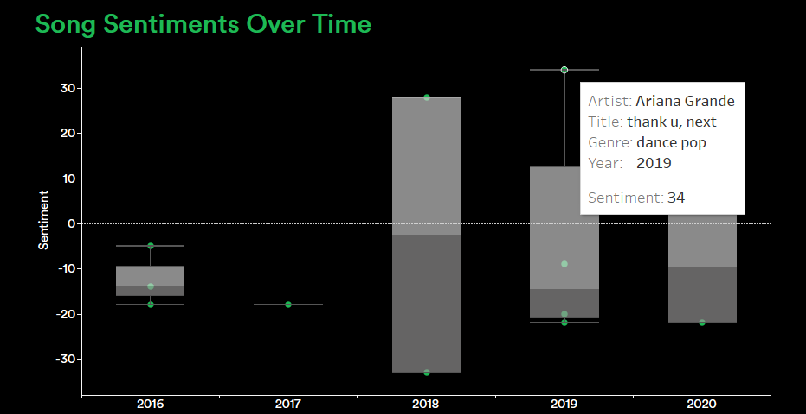
Implementation: Dashboard 2
From there, we can hover over the bar chart on the top left to see which music titles correspond to that year, by the selected artist, that made the top charts.
The values of the music feature also populate as well to show feature values only for Ariana Grande's songs. For example, to the right, we can see that her valence scores often fluctuate but were not as high as they were in 2017. Valence is how optimistic a song is
Lastly, the box plot on the bottom left will show the sentiment score distribution of all of Ariana Grande's songs by year that made the top charts. By hovering over a specific green point, we can see more detail about that song such as it's title, genre and sentiment score.

Slide 16
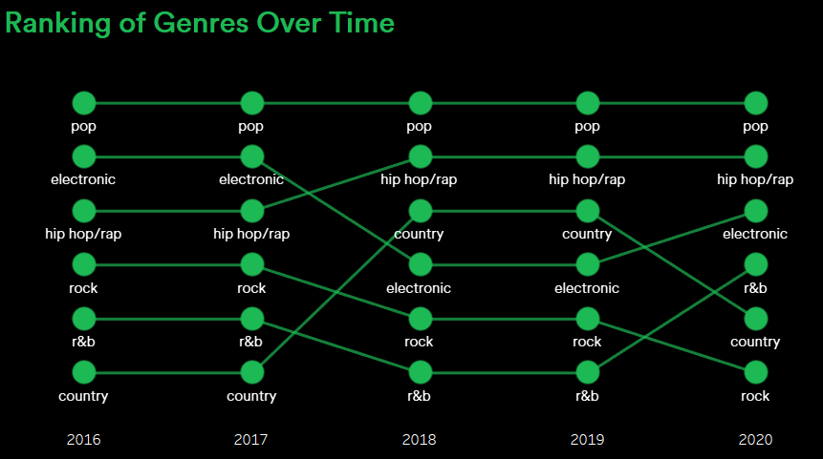
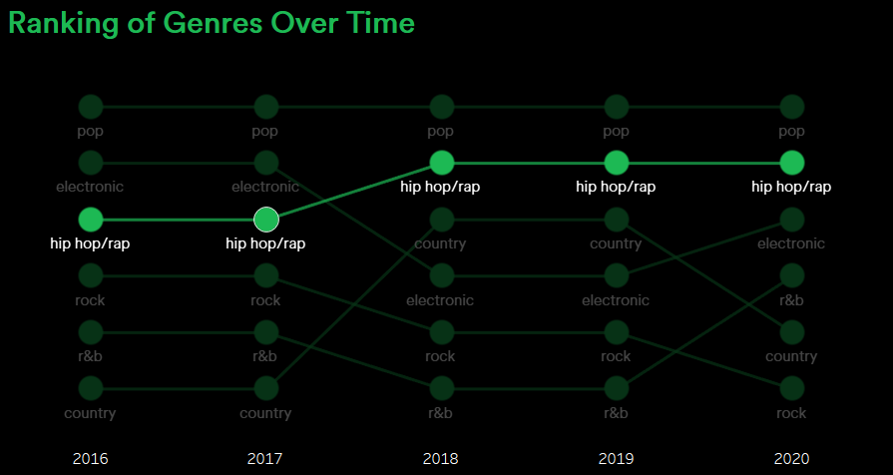
Implementation: Dashboard 2
Lastly, is the bump chart of genres. While this does not have the most interactions associated with it, it is very informative in terms of giving the user information on the trends of each music genre over time. Our design choice was to have all lines and points green in order to match our design aesthetic. However, to improve readability, we labeled each point with words in order to easily distinguish them. We also added a highlight feature so that when the user hovers a certain point, the trend for that genre will be highlighted as shown below to easily determine that one genre's specific trend. For example, we can see from the screenshots below that hip-hop/rap has made its way up to be number two consistently from 2017 to 2018 and has consistently remained number two genre in the most recent years, with pop being consistently number one at the top.

Slide 17
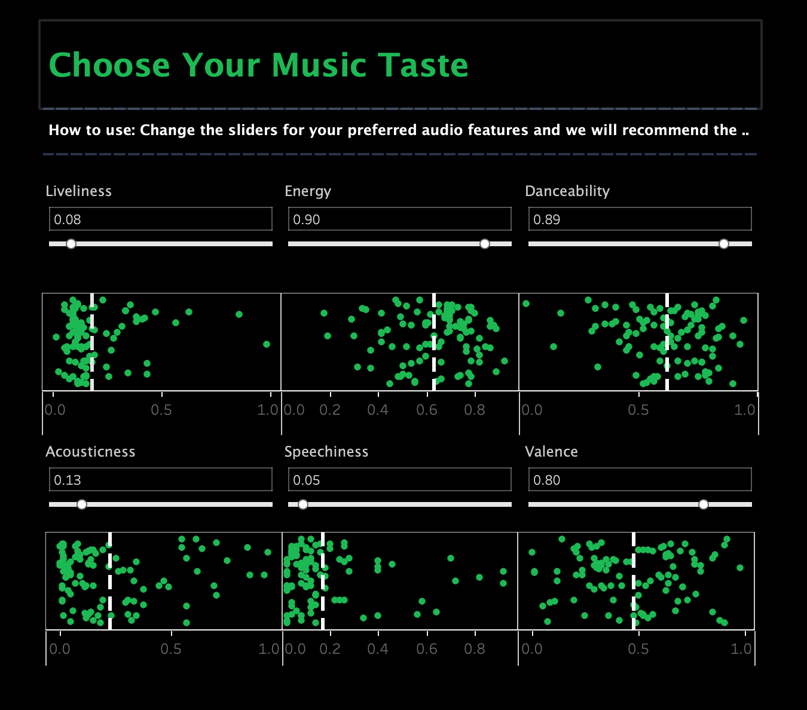
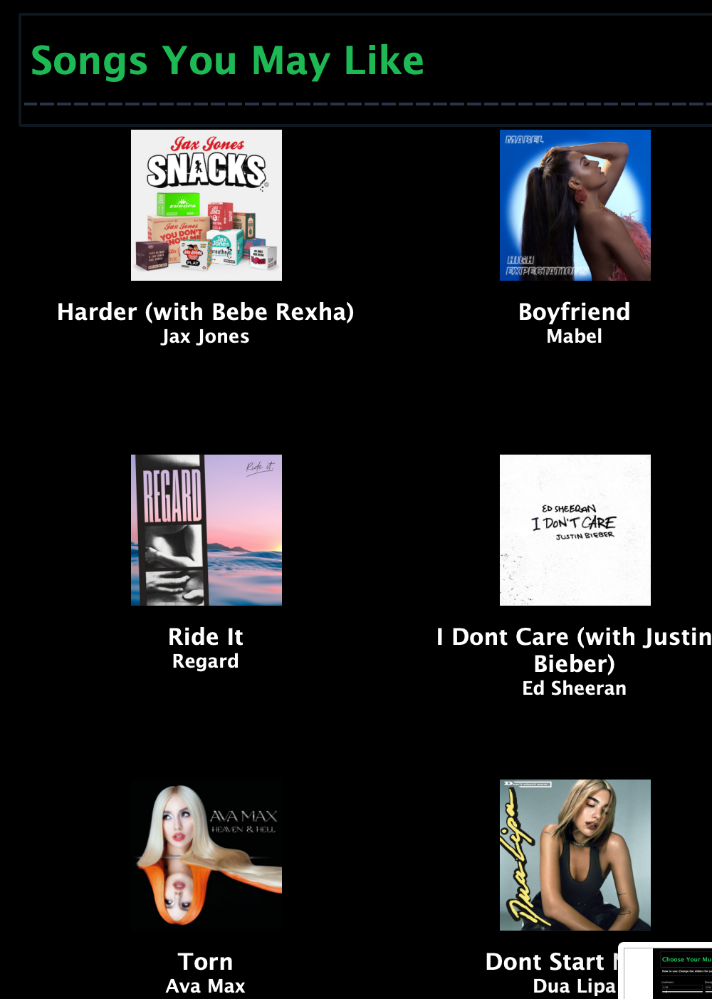
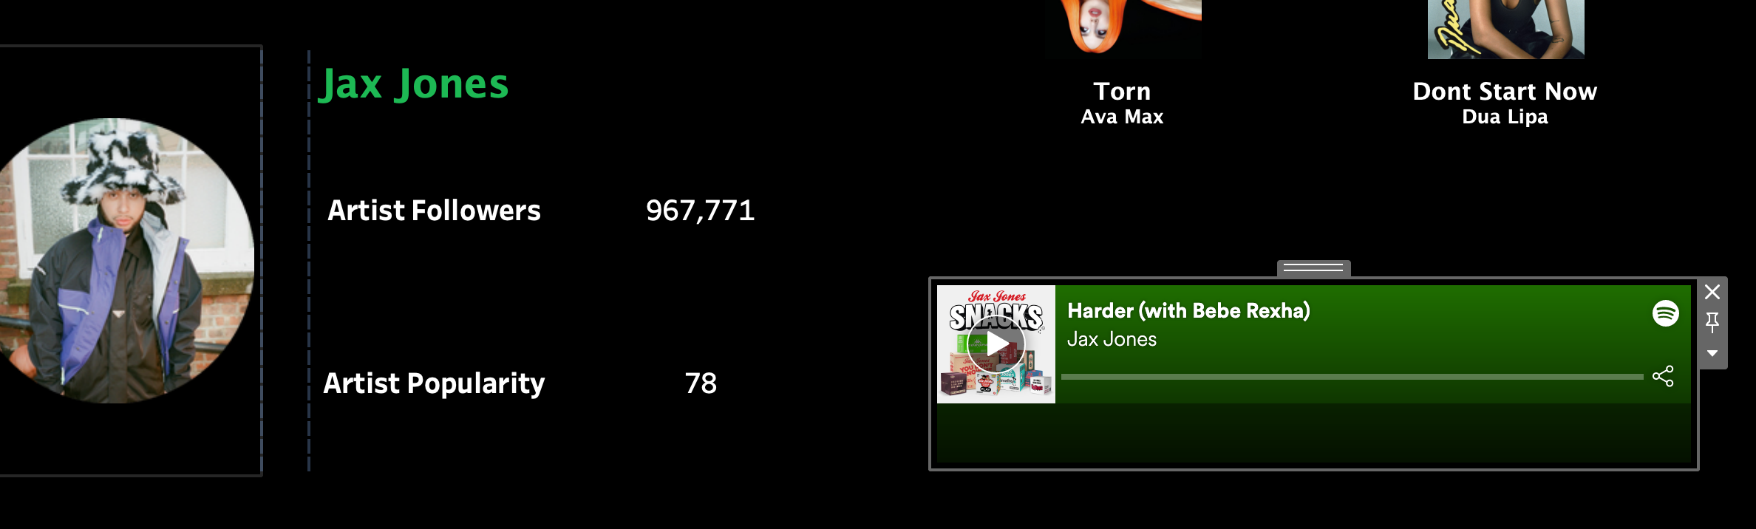
Business Implementation: Part 1
There are a few parties that will benefit from the implementation of our model:
Avid music listeners: Although we do not believe that the general public will likely use our model since our model requires some background knowledge in music theory and is manual compared to the automatic music recommendation system on most music platforms, we believe that our model would provide avid music listeners who clearly know their tastes to find the perfect music for them. For example, the ”choose your music “ section can allow users to adjust the features on the dashboard and find their song either by hovering over the green dots to find the best song that suits their taste or utilize our automatic recommendation component on the right. And lastly, they can listen to the music that they are trying to explore by playing the play button on the far right. If they like the artist, they can then also gain additional information regarding the artist on the “artist information page” that shows on the left of the music player.

Slide 18
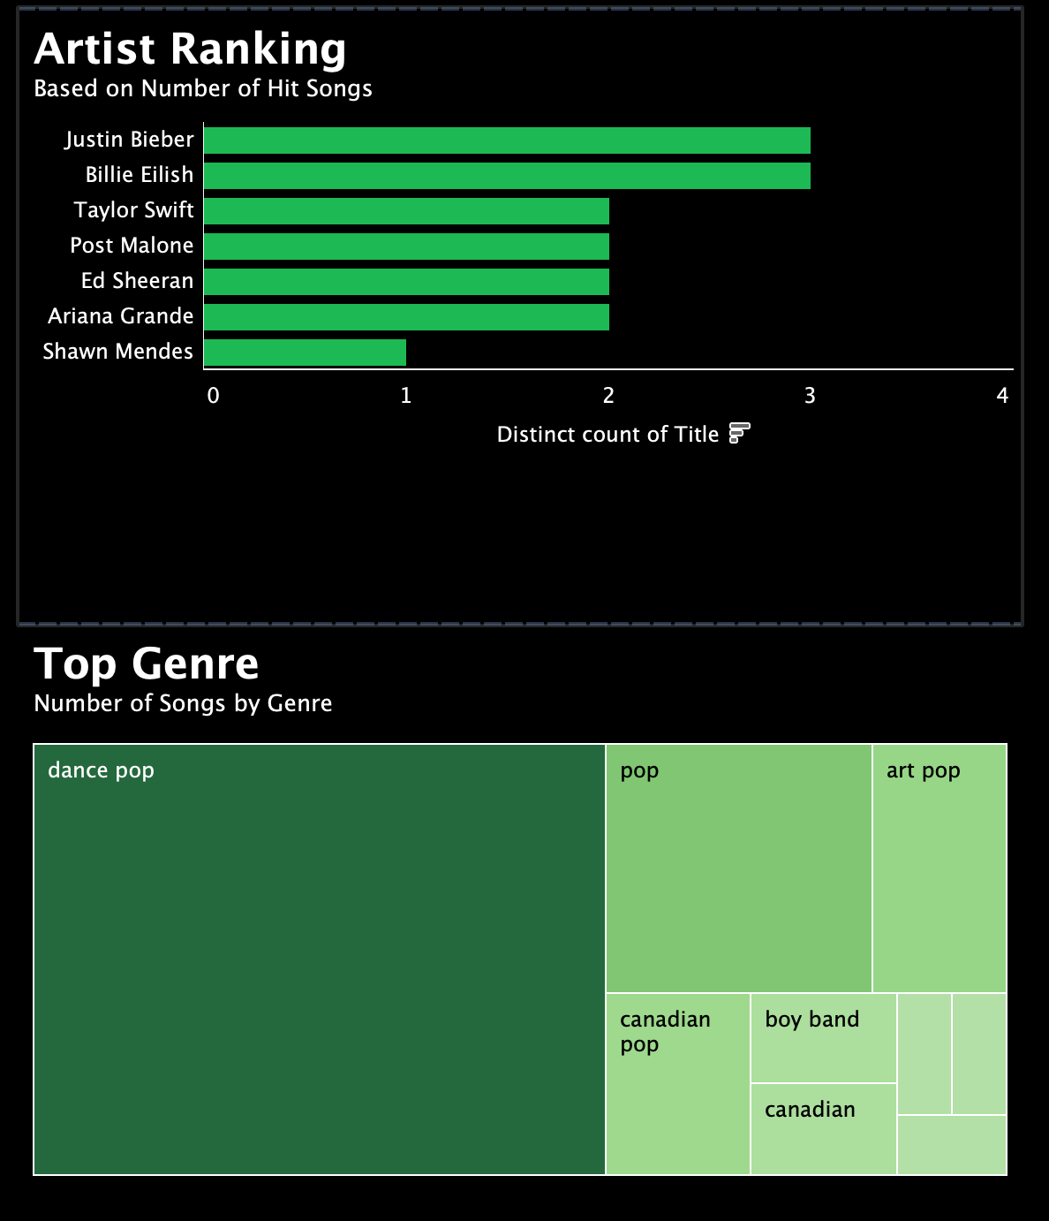
Business Implementation: Part 2
2. Advertisement firms: Advertisement firms can utilize our visualization in order to find the perfect song for their advertisement. For example, if the advertisement requires lively music, it will increase the danceability or loudness. For advertisement firms, it may be similar to what avid music listeners would use but they would also try to look more into the artist ranking or top genres. This is because the popularity of an artist or even playing a song from a top genre could increase people watching and remembering the advertisement. Ideally, they would first choose their desired features through our “choose your music taste” dashboard and then move on to find the best song for them by considering all of the factors that is shown below. Our dashboard would be useful in that it would provide advertisement firms the best song recommendation based on their advertisement and what they are looking for, objectively.

Slide 19
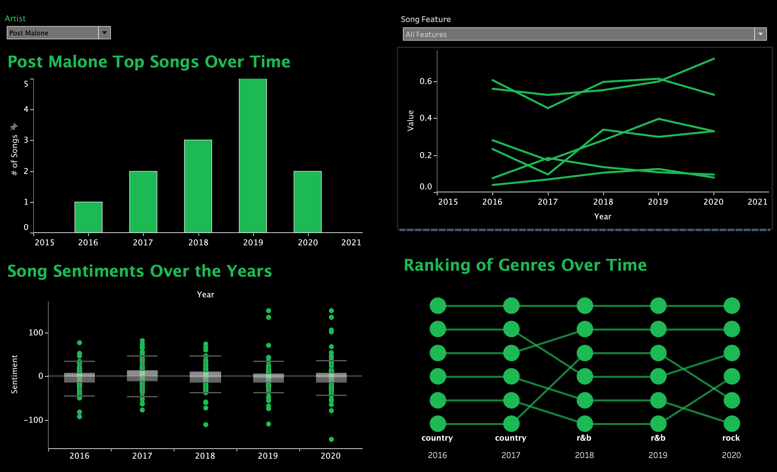
Business Implementation: Part 3
Music Producers: Although our first dashboard can provide useful information to music producers by allowing them to similarly tweak the features that they want when producing music, we believe that the second dashboard, which conducts analysis on trends and music. That is to say, our second dashboard creates value to the our target customers in that it allows them to filter by artist and music characteristics to identify trends and key features throughout time. For example, a music creator in the hip-hop/pop field might take a look into Post Malone songs and see how their top songs are and listen to see what kind of music have made it to the charts. After, they can also look at the three other visualizations on the dashboard (top right, bottom right, bottom left) to identify what the past trends have been. For example, the bottom left viz shows the song sentiment over years. From the screenshot below, we can see that there has been a bigger and bigger gap between the top and bottom sentiment level compared to a more clustered one in around 2017. Although this could be more confusing, it can also provide information regarding the songs and artist. Next, on the top right corner, the artist would be able to identify the change in music feature over time. Next, they can also see the general music genre trends over time and see what kind of genres either had their ups or downs. All in all, the second dashboard provides a much more thorough analysis on the overall music trend and characteristics than the first dashboard, which is more geared towards recommending a certain song or artist to the user.

Slide 20
Insights & Self-Evaluation
Insights from the data:
Ariana Grande and Ed Sheeran has had the greatest number of hit songs across the years of 2016-2020!
For year 2020 specifically, Justin Bieber and Billie Eilish both had the greatest number of hit songs with 3 titles making the charts
How did you answer the questions?
While keeping the questions we had in mind regarding the process, the data and the visualizations that we had, we were able to answer all of these questions by creating our dashboard for all users. Not only did the dashboard provide information regarding the data we had and the business questions that we had for the project, but we also were able to answer any of the additional questions that we had that came up during our project, which are listed in slides 4 and 5 above.
How well does the Viz work and how can we further improve it?
Viz is very user friendly and easy to look at. Due to our aesthetic design choices, we were very limited in our color choices as we wanted to stick to the Spotify Green color. Therefore, for charts like the bump chart, we couldn't use colors to further indicate which genre is which (used highlighter instead)
Further improvements would include incorporating more data in our further analysis dashboard. We would have loved to have data on how each artist's Spotify follower count changed over time as well but were limited by Spotify API. Additionally, if we had more time, we would have loved to include a geographic feature that would indicate which songs were played the most by state or country, etc. But that would require more extensive data scraping.

Slide 21
In Class Presentation

Slide 22

Data Visualization Final Project
Spotify Music:
Recommendation & Analysis
Team 2: Kyu K, Patrick W, Lydia Z, Angela G

Slide 23





Motivation
Data Collection
Mental & Physical Benefits
Grabbed from Spotify Playlist
Official music chart
Name of songs
Plays a role in society
Fun!
Music Features
Danceability
Acoustic-ness
Liveliness
Popularity
Valence
Spotify & Genius API
Song URL, album & artist pic, artist followers & popularity
Song lyrics

Slide 24

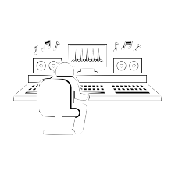

Dashboard Application
Avid Music Listeners
Advertisement Firms
Existing Music Producers/Creators
Provides an alternative ”hands-on” tool to further explore their taste of music
Enables enterprises to select music suitable for their projects
Provides additional tools & info when producing new music

Slide 25





Dashboard Overview
Dashboard 1: Filter by Year (User)
Provides music recommendation based on user's preference, artist ranking and genre during that specific year
Dashboard 2: Change Over Time (Producer)
Contains information and analysis of music taste, genre, ranking, sentiments and so on over time
Innovative Approach #1
Used shapes to make images interactive
Innovative Approach #2
Developed a Tableau-based music recommendation system by ranking each song's distance to the chosen parameter set (similar to kNN)

